Slide 1
Advanced Issues in Collaborative Filtering
Some slides adopted from Francesco Ricci

Slide 2
Content
More evaluation
Variations of the “basic” Collaborative Filtering algorithm
Memory-based CF vs. Model-Based CF
Computational complexity of collaborative filtering

Slide 3
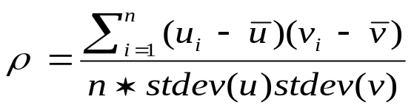

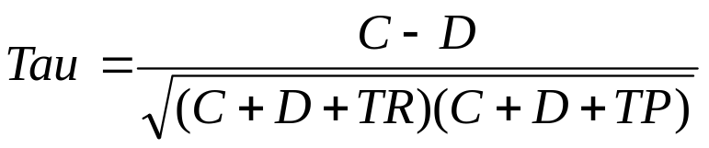
Rank Accuracy Metrics
Rank is the position in the sorted list (and rating?)
Spearman’s rank correlation (u_{i} and v_{i} are the ranks – position in the sorted list - of item i in the user and system order) – it is the same as Pearson but computed on the ranks
Kendall’s Tau (C is the number of concordant pairs – pairs in the same order in both ranked lists – D is the number of discordant pairs, TR tied pairs (same ranking) in the user order, TP tied pair in the predicted order
stdev (x):
Notes:
We shall discuss another measure of rank correlation when talking about hybrid methods (ndpm).

Slide 4
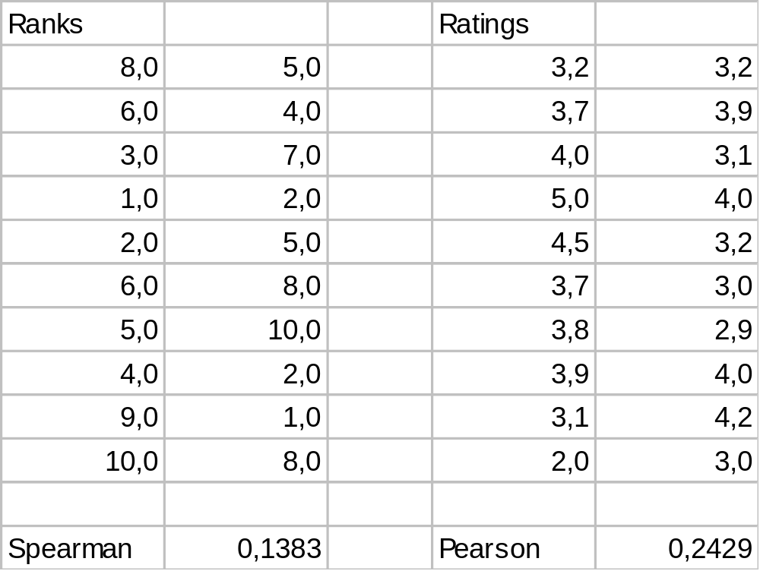
Example
See tau.xls

Slide 5
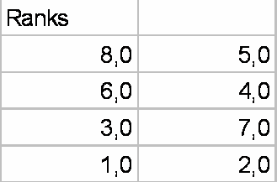
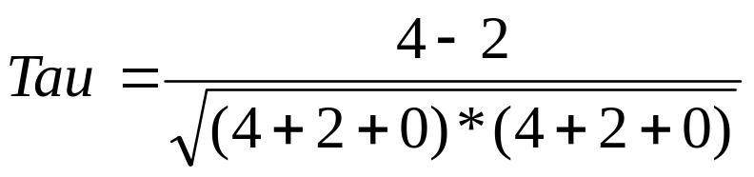
Example
See tau.xls
If the two rankings are the same (perfect agreement) - the coefficient has value 1.
If one ranking is the reverse of the other (perfect disagreement) - the coefficient has value −1.
For all other arrangements the value lies between −1 and 1, and increasing values imply increasing agreement between the rankings.
If the rankings are completely independent, the coefficient has value 0 on average.

Slide 6
Example of Evaluation of a Collaborative Filtering Recommender System
Movie data: 3500 users, 3000 movies, random selection of 100,000 ratings – obtained a matrix of 943 users and 1682 movies
  Sparsity = 1 – 100,000 /(943*1682) = 0.9369
  On average there are 100.000/943 = 106 ratings per user
E-Commerce data: 6,502 customers, 23,554 products and 97,045 purchase records
  Sparsity = 0.9994
  On average 14.9 ratings per user
Sparsity is the proportion of missing ratings over all the possible ratings
  #missing-ratings/#all-possible-ratings.
1-97045/(6502*23554)
All the possible ratings
[Sarwar et al., 2000]
Notes:
Farli riflettere su questi numeri.
So if for instance we split into 80% for training and 20% for testing then we have 23 ratings in the training part (the part that is used to compute the user-to-user similarity) and 5 ratings in the test.

Slide 7
Evaluation Procedure
They evaluate top-N recommendation (10 recommendations for each user)
Separate ratings in training and test sets (80% - 20%)
Use the training to make the prediction
Compare (precision and recall) the items in the test set of a user with the top N recommendations for that user
Hit set is the intersection of the top N with the test (selected-relevant)
Precision = size of the hit set / size of the top-N set
Recall = size of the hit set / size of the test set
they assume that all the items not rated are not relevant
They used the cosine metric in the CF similarity of neighbors.
Notes:
It seems that when they compute the top N recommendations for a user they consider all the possible products that are not included in the training part of the user. This is correct. This is different from what is done when the MAE is used. In that case the prediction is made for all the items that are in the test set and that have been rated by the user.
Stress that when they compute precision and recall they do not take into account the real value of the ratings.

Slide 8
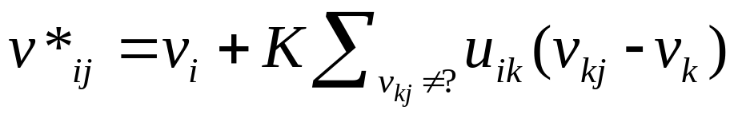
Generation of recommendations
Instead of using the weighted average of the ratings
They used the most-frequent item recommendation method
  Looks in the neighbors (users similar to the target user) scanning the purchase data
  Compute a frequency count of the products in the neighbors purchases - not already in the (training part of the) profile of the target user
  Sort the products according to the frequency
  Returns the N most frequent products

Slide 9
Example:
Top-4 recommended
Frequency of product in neighbors purchases
0
2
1
2
1
3
2
A prediction for this
P=2/4
R=2/3
train
test
Assume that all those depicted are neighbors

Slide 10
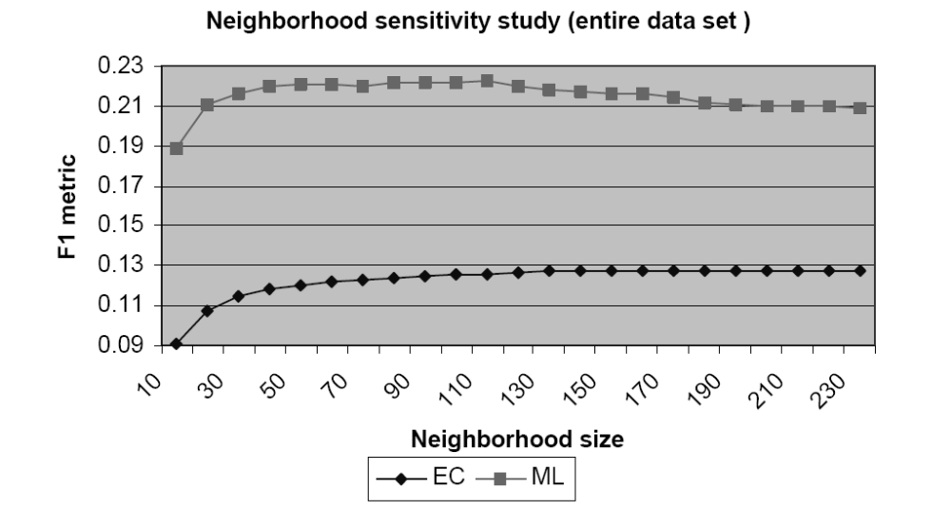
Neighbor Sensitivity
Why F1 is so small?
What is the maximum average recall?
2PR/(P+R)
EC = eCommerce data; ML = MovieLens data
Splitting the entire data set into 80% train and 20% test.
Top 10 recommendations.
Notes:
If the user rated on average n items and the system is retrieving 10 items the maximum recall is 10/n

Slide 11
Neighbor Size
Reducing the neighbor size is important for performance considerations (why?)
If the neighbor size is too high we use in the prediction users that are not much similar to the target user – hence accuracy should decrease
Selection can be made with a threshold similarity:
  drawback: as the number of items increase (average similarity decreases), we can omit users that have ratings for items not covered by similar users
Selection can be made with a fixed k – accuracy for users with more unique preferences will be lower
There is a need to develop a more “adaptive” neighbor formation algorithm – it must depend on the global data characteristics and the user and item specific ratings.
Notes:
Discuss it at the exercise.
More neighbors must increase the recall, less neighbors increase precision.

Slide 12
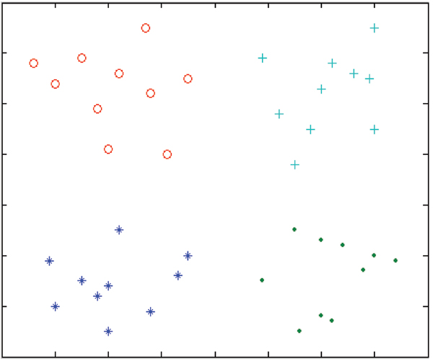
Users with 2 ratings
4 nearest neighbors
0 nearest neighbors
4 nearest neighbors
Fixed similarity for two users may mean completely different neighbors

Slide 13
Improvements of CF
Using a significance weighting that tells how dependable the measure of similarity is – measured as a count of the number of items used in the similarity computation [Herlocker et al., 1999]
  Min(|P_{i} ∩ P_{j}|, 50)/50 : where P_{i} , P_{j} are the product rated by user i and j (50 is a parameter – 50 items are considered enough to have optimal similarity computation)
  Used in prediction as a correlation significance weighting factor to devalue similarity weights that based on a small amount of co-rated items
  This approach improves the prediction accuracy (MAE)

Slide 14
Dependability in the similarity measure
u₁
4
Overlapping ratings with u₁
6
4
5
5
4
Means that there is a rating for that user-item pair

Slide 15
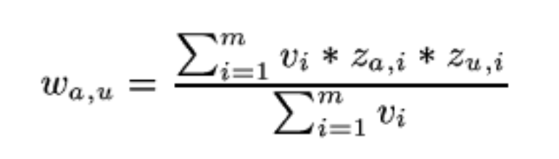
Improvements of CF, cont.
Not all items may be informative in the similarity computation – items that have low variance in their ratings are supposed to be less informative than items that have more diverse ratings [Herlocker et al., 1999]
  He gave more importance, in the similarity computation, to the products having larger variance in ratings – this did not improve accuracy of the prediction.
  Used in selecting neighbors (similarity measure) to increase the influence of items with high variance in rating and decrease the influence of items with low variance

Slide 16
Low variance vs. High variance ratings
u₁
5
5
4
Overlapping ratings with u₁
5
1
6
5
4
5
2
5
5
3
5
5
4
4

Slide 17
Correlated vs. De-correlated items
p₁
p₂
p₃
u₁
1
5
5
5
1
2
5
5
2
2
2
3
3
4
4
Assume that we want to predict the rating of user u₁ for item p₃.
Would it be more useful to base the similarity on ratings
for item p₁ or p₂?

Slide 18
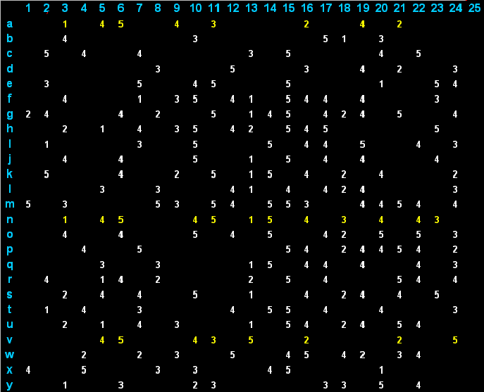
Matrix of ratings
Items
Users

Slide 19
Lazy and Eager Learning
Lazy: wait for query before generalizing
  k-Nearest Neighbor
Eager: generalize, i.e., build a model, before seeing query
  Radial basis function networks, ID3, Neural Networks, Naïve Bayes, clusters, association rules
Does it matter?
  Eager learner must create global approximation
  Lazy learner can create many local approximations

Slide 20
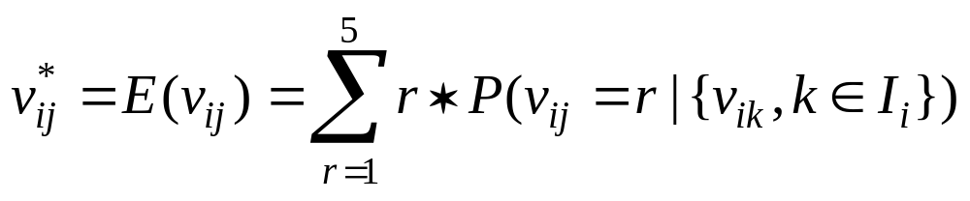
Model-Based Collaborative Filtering
Previous approach is called “lazy’ or memory-based as the original examples (the vectors of user ratings) are used when a prediction is required (no computation when data is collected)
Model based approaches build and store a probabilistic model and use it to make the prediction
Where r=1, …5 are the possible values of the rating and I_{i} is the set of (indexes of) products rated by user i
The probabilities above are estimated with whatever classifier that can output the probability for an example to belong to a class (the class of products having a rating = r), e.g., Naïve Bayes
User model

Slide 21
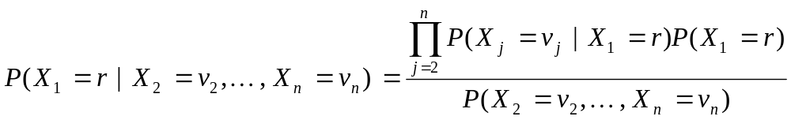
Naïve Bayes
P(H|E) = [P(E|H) * P(H)] / P(E)
Example:
  P(flue | fever) = P(fever | flue) * [P (flue) / P(fever)]
  P(flue | fever) = 0.99 * P(flue) / P(fever) = 0.99*0.01/0.03= 0.33
In case of ratings, a class is a particular rating for a particular product (e.g., the first product). X_{i} is a variable representing the rating of a generic user to product i
Assuming the independence of the ratings on different products

Slide 22
Association Rules
Discovering association between sets of co-purchased products – the presence of a set of products “implies” the presence of others
{p₁, …, p_{m}} = P are products, and a transaction T is a subset of products P
Association rule: X → Y
X,Y are not overlapping subsets of P
The meaning of X → Y is that in a collection of transactions T_{j} (j=1, …N), if X are present it is likely that Y are also present
We may generate a transaction for each user in the CF system: contains the products that have been rated by the user.

Slide 23
Support and Confidence
Support is a measure of the frequency that a pattern (X and Y) is observed in the transactions
  S(X → Y) = (# transactions containing X and Y) / (# transactions)
Confidence is a measure of the strength of the rule i.e. the probability that a transaction that contains X will also contain Y
  C(X → Y) = (# transactions containing X and Y) / (# transactions containing X)
Confidence is the conditional probability that Y can be observed in a transaction given the fact that we observed X
C(X → Y) = S(X → Y) / S(X)
P(A|B) = P(A ∩ B) / P(B)
Notes:
P(X & Y) / P(X) = P(Y | X)

Slide 24
Example
Users=Transactions
Support = proportion of transactions that contains X and Y = 3/6
Confidence = proportion of those that contains X and Y over those containing X = 3/4
Items
X
Y

Slide 25
Association Rules and Recommender
Long term user profile: a transaction for each user containing all the products both in the past
Build a set of association rule (e.g. with the "Apriori" algorithm) with a given minimum confidence and support (using all the users or only the users close to the target)
  [Sarwar et al., 2000] used all the users-transactions to build the association rules
Find the rules R supported by a user profile (i.e. X is in the user profile)
Rank a product in the right-hand-side of some rules in R by the (maximal) confidence of the rules that predict it
Select the top-N
[Sarwar et al., 2000]

Slide 26
Comparison- Memory-based , Model based
Memory based
  (+) More accurate
  (+) New data immediately affects the prediction
  (-) Doesn’t scale without sampling
Model based
  (+) Less data needed at runtime
    Less storage needed
    Less data processing time
  (-) New data doesn’t immediately affect the model
    Need to rebuild the model
  (-) Discarded data can reduce precision

Slide 27
Problems of CF : Sparsity
Typically we have large product sets and user ratings for a small percentage of them
Example Amazon: millions of books and a user may have bought hundreds of books –
  the probability that two users that have bought 100 books have a common book (in a catalogue of 1 million books) is 0.01 (with 50 and 10 millions is 0.0002) – if all books are equally likely to be bought!
1-(10⁷-50/10⁷⁾⁵⁰
1-(999900/10⁶⁾¹⁰⁰
(N-n)/N - probability that in a catalogue of N books a random book is not in subset of n,
[(N-n)/N]^{n} - probability that if the second user selects randomly n books the two sets are disjoint.
Notes:
The probability that in a catalogue of N books a random book is not in subset of n is (N-n)/N, hence [(N-n)/N]^n is the probability that if the second user selects randomly n books the two sets are disjoint.

Slide 28
Sparsity
Popular Items
u₁
3
Overlapping ratings with u₁
6
5
5
3
4
Not popular Item

Slide 29
Popular vs Not Popular
Predicting the rating of popular is easier than for not popular
  The prediction can be based on many neighbors
The usefulness of predicting the rating of popular items is questionable:
  It could be guessed in a simpler way
  The system will not appear as much smart to the user
Predicting the rating of unpopular items is
  Risky: not many neighbors on which to base the prediction
  But could really bring a lot of value to the user!

Slide 30
Problems of CF : Scalability
Nearest neighbor algorithms require computations that grows with both the number of customers and products
With millions of customers and products a web-based recommender will suffer serious scalability problems
The worst case complexity is O(m²*n) (m customers and n products) – for each user calculate nearest neighbors – O(m*n)
But in practice the complexity is lower since for each customer only a small number of products are considered (one loop on the m customers to compute similarity PLUS one on the n products to compute the prediction). The loop to find the similar neighbors is heavy.
Notes:
The major problem is the computation of nearest neighbors of a user that requires to scan all the users and for each user to compute the similarity you must scan all the ratings.
To compute the similarity in a fast way one can use indexing methods.

Slide 31
Computational Issues
u₁
To compute the similarity of u1 with the other users we must scan the users database m (large) but only 3 products will be considered (in this example)
Represent a user as u1 = [(p_{1,1}, r_{1,1}), (p_{1,6}, r_{1,6}), (p_{1,12}, r_{1,12})]

Slide 32
Computational Issues
u₁
When you have selected the neighbors
u3 = [(p_{3,1}, r_{3,1}), (p_{3,3}, r_{3,3}), (p_{3,8}, r_{3,8}), (p_{3,12}, r_{3,12})]
u4 = [(p_{4,3}, r_{4,3}), (p_{4,6}, r_{4,6}), (p_{4,12}, r_{4,12})]
You must only scan the union of the products in the neighbors’ profiles and identify those not yet rated by the target user u1
{1,3,6,8,12}
{3,8}

Slide 33
Some Solutions
Discard customers with few purchases
Discard very popular items
Partition the products into categories
Dimensionality reduction (LSI (Latent semantic analysis) or clustering data)
All of these methods also reduce recommendation quality (according to [Linden et al., 2003]).
Compute similarity on a sampling that could be handled
[Linden et al., 2003]

Slide 34
Summary
Example of usage of precision and recall in the evaluation of a CF system
CF using only the presence or absence of a rating
Association rules
Comparison between CF and association rules
Illustrated the relationships between CF and classification learning
Briefly discussed the notion of model-based CF
Naïve Bayes methods
Discussed some problems of CF recommendation: sparsity and scalability
Discussed the computational complexity of CF

